Slide 1


Predicting Loan Default Risk
Joseph Damico
11/07/2024
DSC630-T301 Predictive Analytics
Notes:
Transcript:
Welcome to my presentation on predicting loan default risk. My name is Joseph Damico, and today I'll walk you through my project where I developed a predictive model to assess the risk of loan default. This presentation will cover the problem's significance, the dataset, methods, results, and key findings.

Slide 2
Problem Statement
Problem: Banks need to accurately predict loan default to reduce losses and optimize lending.
Impact: Incorrectly assessing risk can result in financial losses or missed revenue opportunities.
Notes:
Transcript:
Loan default is a major concern for banks and lending institutions. Incorrectly evaluating a borrower’s risk can lead to significant financial losses or missed revenue opportunities. This project aims to develop a model to accurately predict loan default allowing banks to make better data-driven lending decisions.

Slide 3

Importance of the Problem
Why It Matters: Helps banks balance risk and lending opportunities. Provides new opportunities to lend to customers they originally wouldn’t.
Audience: Bank executives, risk assessment teams, and loan officers.
Notes:
Transcript:
The ability to predict loan default risk is crucial because it helps banks balance risk with lending opportunities. Key stakeholders who would benefit from this model include bank executives, risk assessment teams, and loan officers, all of whom rely on data to make better decisions regarding loan approvals and terms.

Slide 4
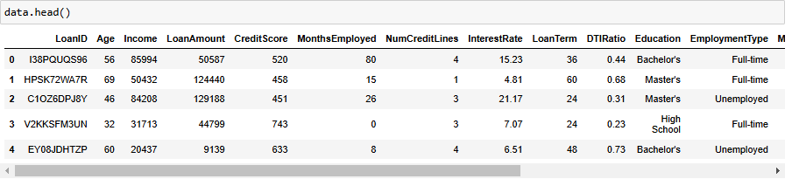
Data Overview
Data Source: Kaggle
Features: Age, income, loan amount, credit score, employment type, marital status, and default status.
Notes:
Transcript:
The data for this project was sourced from Kaggle and includes essential features such as age, income, loan amount, credit score, employment type, and marital status, along with a target variable that indicates whether or not the loan defaulted. These features allow us to build a predictive model that considers various aspects of a borrower's financial situation and other key variables.

Slide 5
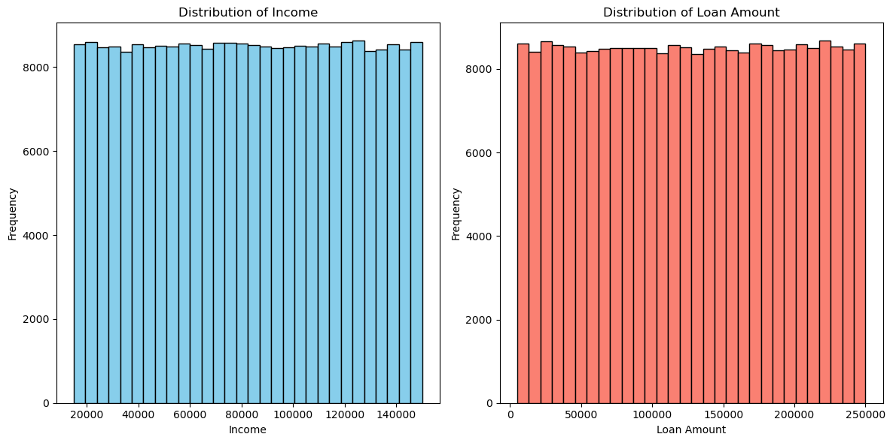
Data Exploration
Exploration Highlights:
Histograms for distribution of income, loan amount.
Box plots for credit score across default groups.
Correlation heatmap of variables.
Notes:
Transcript:
Initial data exploration included visualizations like histograms to show income and loan amount distributions, box plots to compare credit scores across default and non-default groups, and a correlation heatmap. These visualizations helped identify key patterns and relationships in the data that would inform the modeling approach. Some visualizations proved not to be useful and added more confusion for a short period.

Slide 6
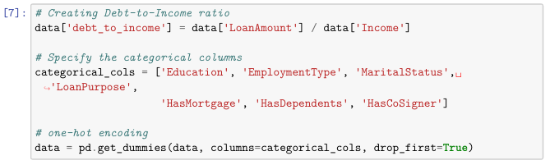
Data Preparation
Steps Taken:
Handled missing data with mean and mode imputation.
Created a debt-to-income ratio feature.
One-hot encoded categorical variables.
Applied SMOTE to address class imbalance.
Notes:
Transcript:
To prepare the data missing values were handled through mean and mode imputation. A debt-to-income ratio feature was engineered to assess the borrower's financial health. Categorical variables were one-hot encoded and SMOTE was applied to balance the classes ensuring that the model learned from both default and non-default cases effectively.

Slide 7
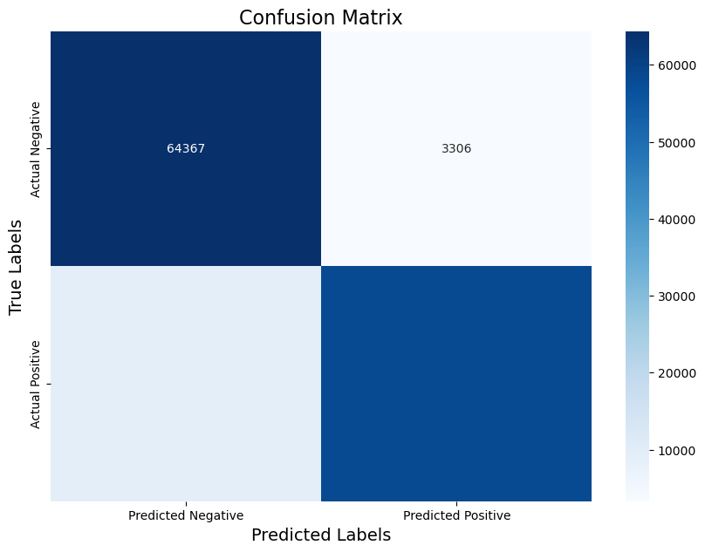
Model Selection
Models Tested: Logistic regression, Random Forest
Final Model: Random Forest due to better performance with non-linear data
Notes:
Transcript:
I tested several models including logistic regression and random forest. The random forest model was chosen as the final model due to its superior performance in handling non-linear relationships and its ability to achieve higher accuracy for this prediction task.

Slide 8

Model Evaluation Metrics
Metrics Used:
Precision, Recall, F1-Score, AUC-ROC
Reason for Metrics: Balances accuracy, minimizes false negatives
Notes:
Transcript:
To evaluate the model I used precision, recall, F1-score, and AUC-ROC. These metrics provided a comprehensive view of model performance balancing accuracy while minimizing false negatives, which is essential in predicting loan default where missing a true positive can be costly for banks.

Slide 9
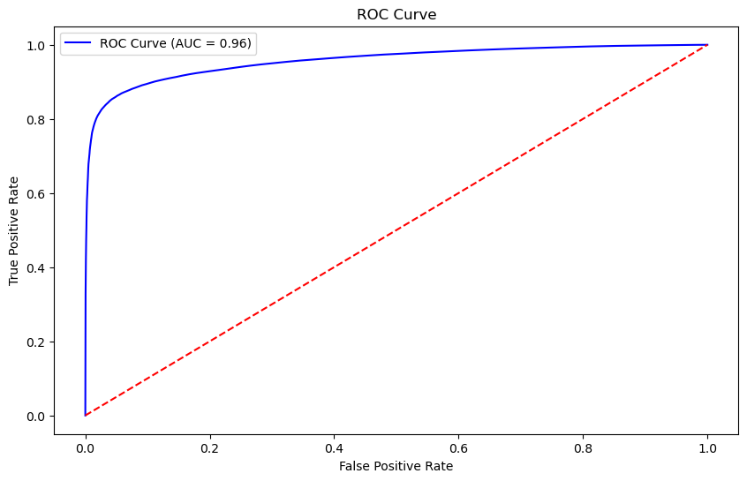
Results
Performance Highlights:
High precision and recall in identifying defaults.
AUC-ROC score of 0.96, indicating strong model performance.
Visuals: Include confusion matrix and ROC curve.
Notes:
Transcript:
The final random forest model achieved high precision and recall indicating effective identification of defaults. The model's AUC-ROC score was 0.96 demonstrating strong performance in distinguishing between default and non-default cases. Here I’ve included the ROC curve to illustrate these results.

Slide 10

Interpretation of Results
Implications:
High precision and recall suggest reliability.
Effective tool for risk-based decision making.
Notes:
Transcript:
These results suggest that the model is a reliable tool for predicting loan default risk with high precision and recall making it suitable for identifying risky borrowers. This model could be used in real-world scenarios to support risk-based decision-making in the loan approval process.

Slide 11
Conclusion
Key Learnings:
Debt-to-income ratio, credit score as key predictors.
Model can be integrated into loan approval process.
Recommendations:
Interest rate adjustments based on risk.
Notes:
Transcript:
Key learnings from the project include the importance of factors like debt-to-income ratio and credit score in predicting loan default. This model could be integrated into the loan approval process to assess borrower risk with the added recommendation of adjusting interest rates based on each borrower’s risk profile.

Slide 12
Ethical Considerations
Bias and Fairness: Ensure no discrimination.
Privacy: Maintain confidentiality and data security.
Notes:
Transcript:
Ethical considerations are vital when deploying predictive models in finance. Bias and fairness must be carefully monitored to prevent discrimination and borrower privacy needs to be maintained through secure handling of data in compliance with relevant regulations.

Slide 13

Future Work
Future Enhancements:
Additional features, such as external credit data.
Integrate a dynamic interest rate model.
Notes:
Transcript:
Future work could include adding external credit data and macroeconomic indicators to improve the model's predictive power. Additionally, a dynamic interest rate adjustment model could be implemented to offer interest rates that correspond to a borrower's risk level helping to optimize the lending strategy.
I appreciate the opportunity to share this project with you.

